Slide 1

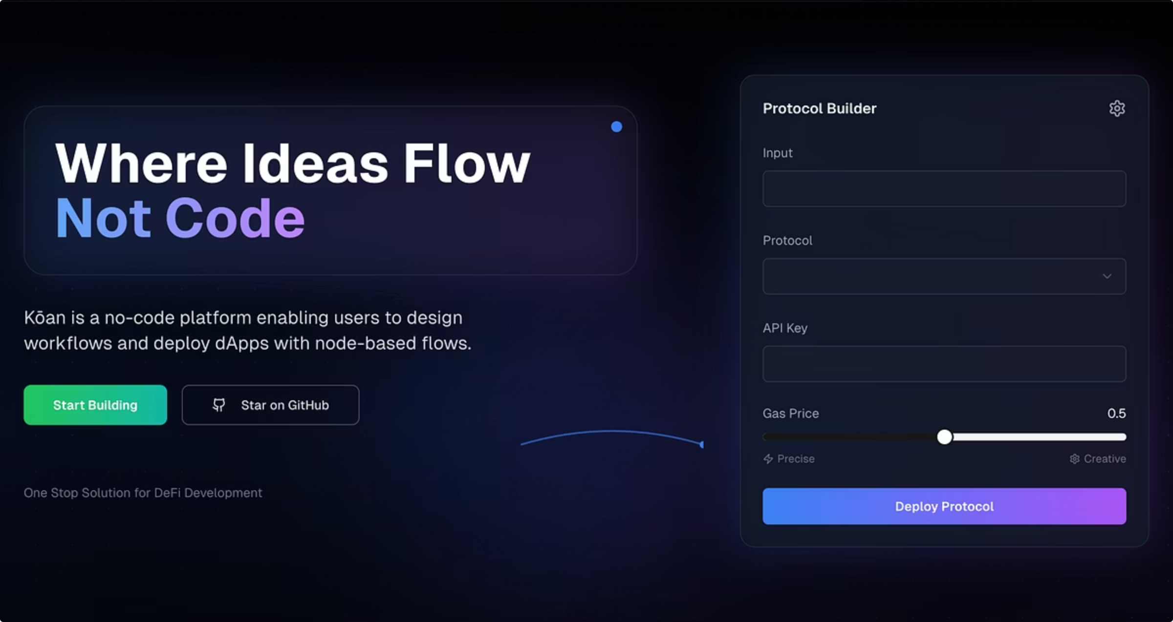
Köan: AI No-Code for DApps
Welcome to our vision for the future of decentralized application development. In this presentation, we'll introduce an innovative AI no-code platform designed to democratize access to blockchain technology. Our goal is to empower both technical and non-technical users to build and deploy powerful DApps with unprecedented ease, transforming ideas into functional products without a single line of code.

Slide 2
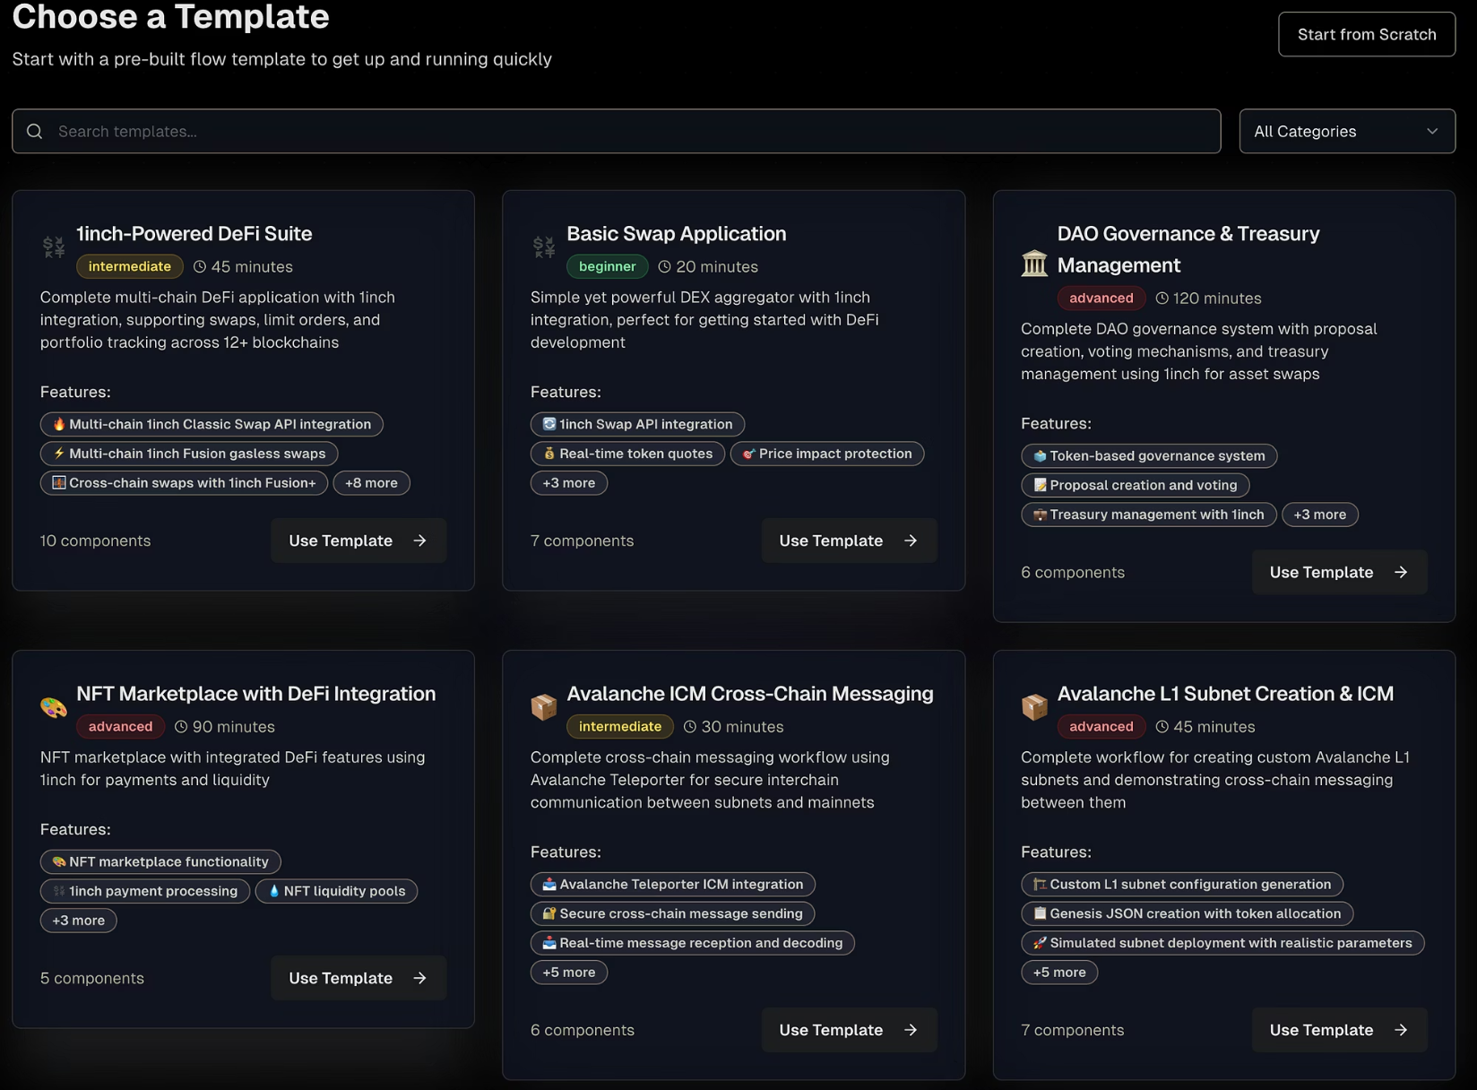

Chapter 1
The Vision
Our primary objective is to create an AI no-code platform that enables users to visually design complex workflows and deploy decentralized applications (DApps) using a modular, node-based system.
This system will be exposed via a user-friendly website, with future plans for an API. This dual approach ensures that both technical and non-technical users can build, customize, and leverage the full potential of DApps.

Slide 3

Why Now?
Future-Proofing Development
Lowering Barriers to Entry
Accelerating Innovation
The rapid rise of no-code platforms (e.g., Lovable's $100M ARR in 8 months) signals a paradigm shift. We're building for a future where no-code dominates development, making blockchain accessible to the masses.
DeFi tools are powerful, but their creation often requires deep coding expertise. Our platform will democratize access, allowing users to build sophisticated applications without writing a single line of code.
For developers and strategists, our platform offers a rapid prototyping environment. Go from a nascent idea to a functional, deployable DApp with unprecedented speed, fostering experimentation and innovation.
For Non-Developers: The AI will translate natural language inputs into functional workflows, intelligently understanding and constructing node structures and components to bring their ideas to life.

Slide 4
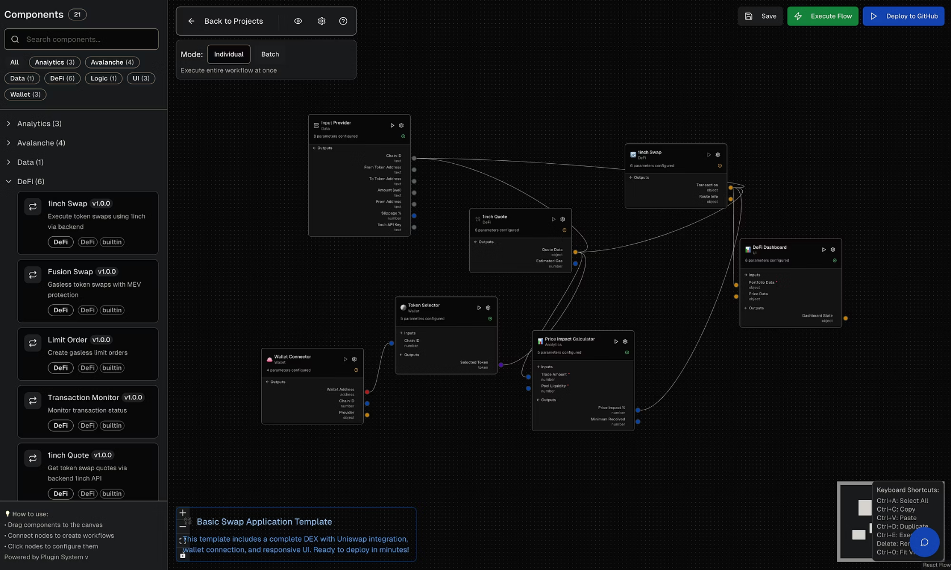
Chapter 2
Foundational Concepts: The Node-Based Architecture
At the core of our platform are nodes, each representing a specific function within the blockchain ecosystem. Think of them as modular building blocks:
Wallet Connection Node: Facilitates secure connection to various crypto wallets.
Swap Node: Enables token exchanges across different liquidity pools.
Liquidity Provision Node: Allows users to add or remove liquidity to DeFi protocols.
Smart Contract Interaction Node: Executes functions on pre-existing smart contracts.
Data Feed Node: Integrates real-time market data or external APIs.
Users will combine these nodes in intuitive, drag-and-drop interfaces to create complex DApp flows, visually constructing their desired product.
Example: Visualizing a simple 'Connect Wallet & Swap' flow.

Slide 5
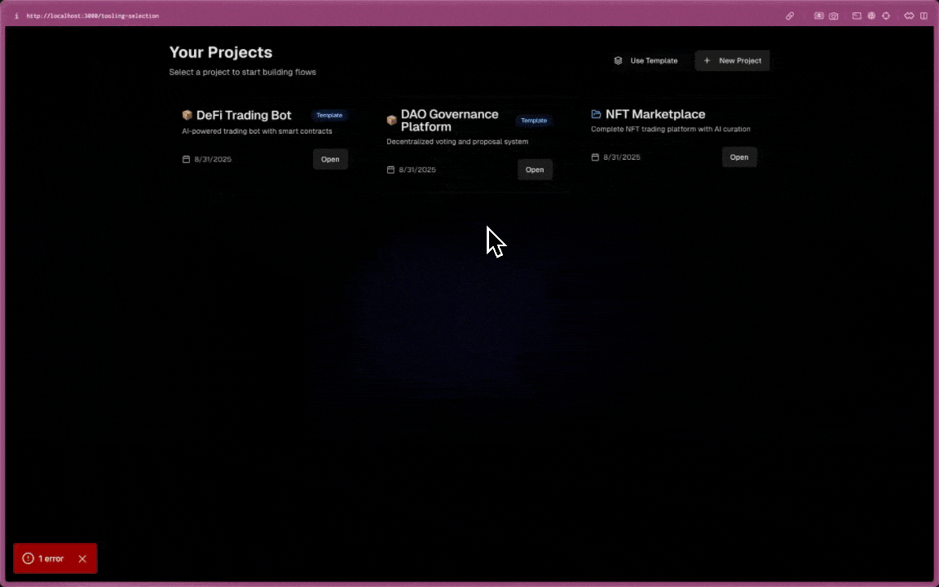
The AI as Your DApp Architect
1
2
3
Interpreting High-Level Goals
Automated Node Curation
Seamless Workflow Generation
The AI will act as a "DApp architect," interpreting natural language input. For example, a user might say, "I want to build an arbitrage bot."
Based on the goal, the AI will perform "node calls" (akin to tool calls), curating and connecting the entire node flow autonomously. This automates the complex logic behind DApp creation.
Initially, a single agent will manage this process, focusing on generating a complete and functional node flow ready for deployment. This minimizes manual configuration and accelerates development.
The AI translates natural language into complex DApp workflows.

Slide 6
Templates To Kickstart Your Projects
Not every user wants to build from scratch. Our platform will provide a rich library of pre-built templates, offering a fast track to common DApp functionalities. These templates serve as excellent starting points, allowing users to customize and expand upon established structures.
Basic Swap Application
1inch Defi Suite
Avalanche ICM Cross-Chain Messaging
Avalanche L1 subnet
These templates demonstrate the platform's versatility and provide immediate value, inspiring users to explore further customization and creation.

Slide 7
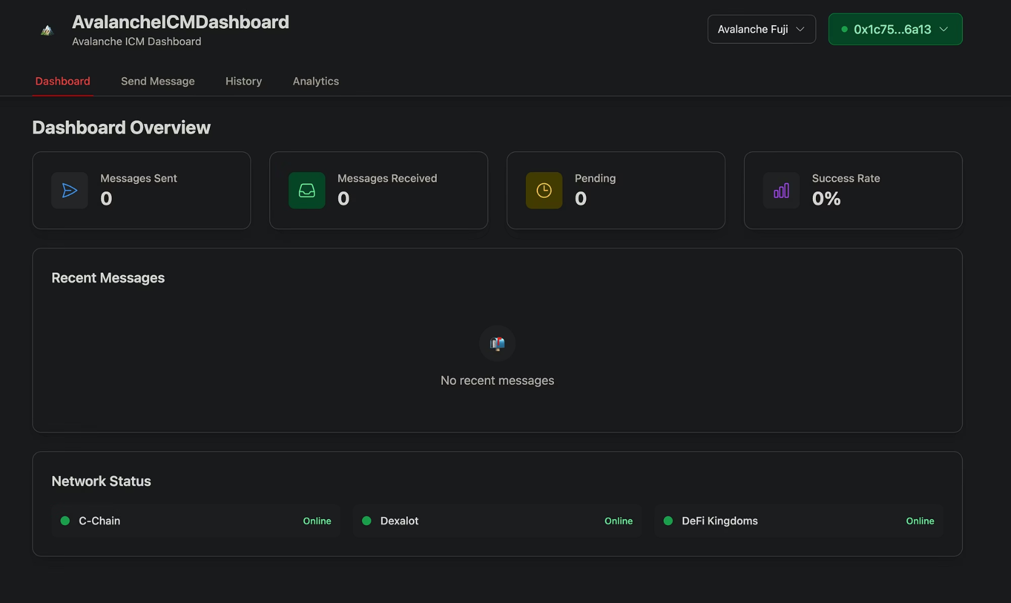
Output & Hosting
The final output of a user's DApp creation will be a templated frontend dashboard, providing a user-friendly interface for their deployed application. This means users don't just get code; they get a functional, interactive product.
The backend will consist of API services developed by our team, ensuring seamless communication and execution. We will compile smart contracts with executable engines and interact with them directly via their ABI and contract addresses, guaranteeing decentralized functionality.
All critical components – the frontend's templated dashboard code and the backend's API services (including user input and API keys) – will be securely hosted on GitHub. This provides transparency, version control, and a clear pathway for future community contributions and scalability.

Slide 8
Chapter 3
The Impact?
High Barrier to Entry: Requires deep coding expertise (Solidity, JavaScript, etc.).
Zero Code Required: Visual design, natural language input.
Time-Consuming: Months of development, testing, and auditing.
Rapid Deployment: Weeks, days, or even hours from idea to functional DApp.
Expensive: High developer salaries, audit costs.
Cost-Effective: Reduces need for specialized talent, optimizes resources.
Limited Access: Excludes non-technical innovators.
Universal Accessibility: Empowers anyone with an idea to build.
Steep Learning Curve: Understanding blockchain nuances, smart contracts.
Intuitive Interface: Abstract complexities, focus on outcome.
Our platform transforms DApp development from an exclusive technical domain into an accessible, creative playground for all.

Slide 9
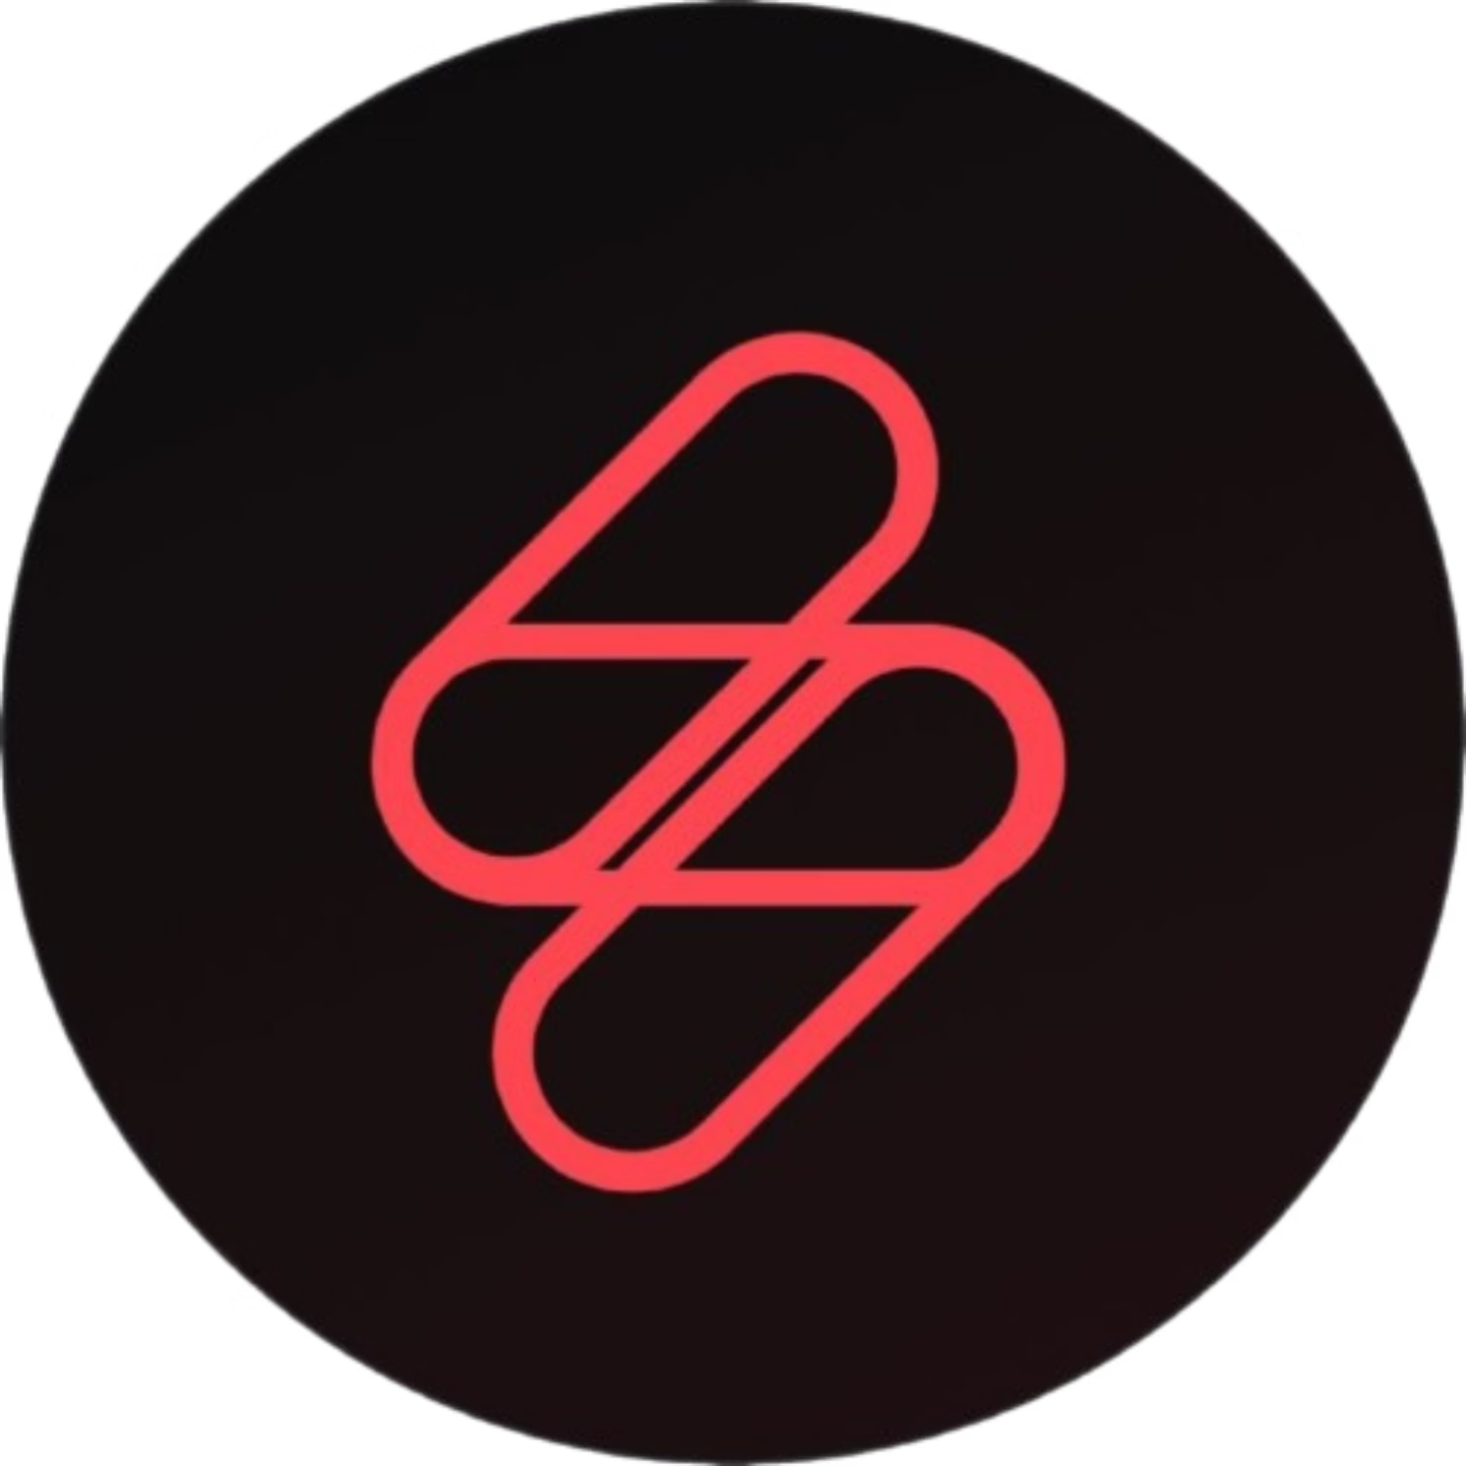
Thank you

